Slide 1
Rotten Potatoes
Music Reviews
GROUP 14

Slide 2

Rotten Potatoes
Rotten Potatoes is a website and mobile application that lets you explore and review music.
You can read and post reviews as well as browse albums from a multitude of genres.
There are links to different storefronts where you can also listen to or purchase the music you have been browsing.

Slide 3
Team Members
James - PHP, Javascript, Logo
Katelyn - Web User Interface, Javascript
Jared - Database Management
Matt - Mobile App
Terrence - Mobile App
EJ - Javascript, Web User Interface

Slide 4
Architecture
LAMP Stack
Hosted on Amazon AWS
Front end tech
HTML/CSS - Bootstrap
JavaScript
Source Control
GitHub
Mobile Development
Android Studio (Java)
Google Volley

Slide 5
Website
PHP Sessions are created when users log in
Admin pages will only render for admins
Guests get a message encouraging them to register

Slide 6
Spotify Integration
Authenticates with Spotify using their server-to-server authentication
Albums can be searched with dynamic results to allow us to quickly add albums
Songs with valid previews have their URL’s stored in the database
Album art comes from Spotify

Slide 7
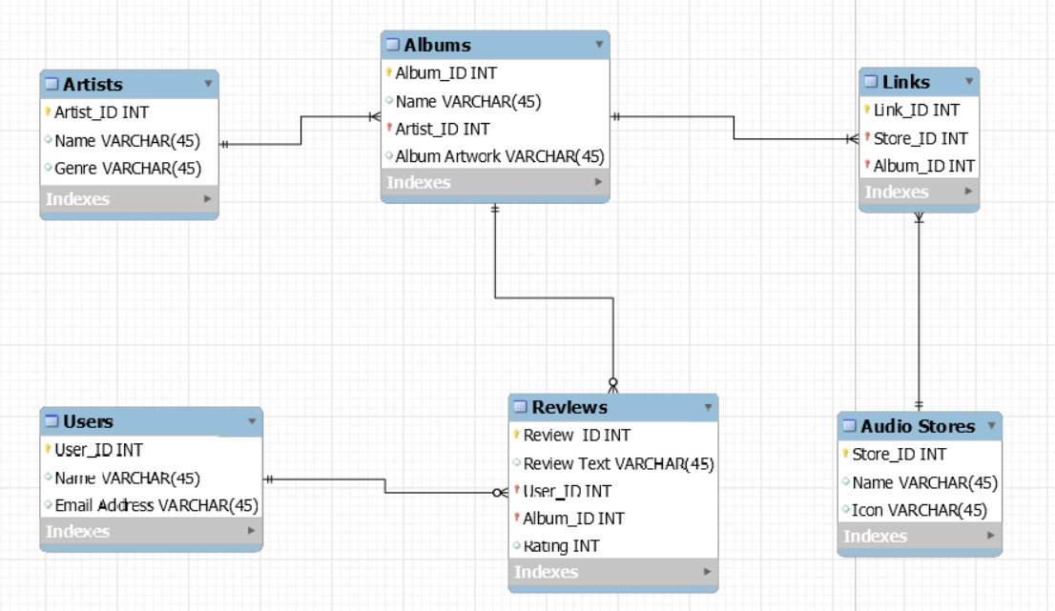
Database Design - ERD

Slide 8
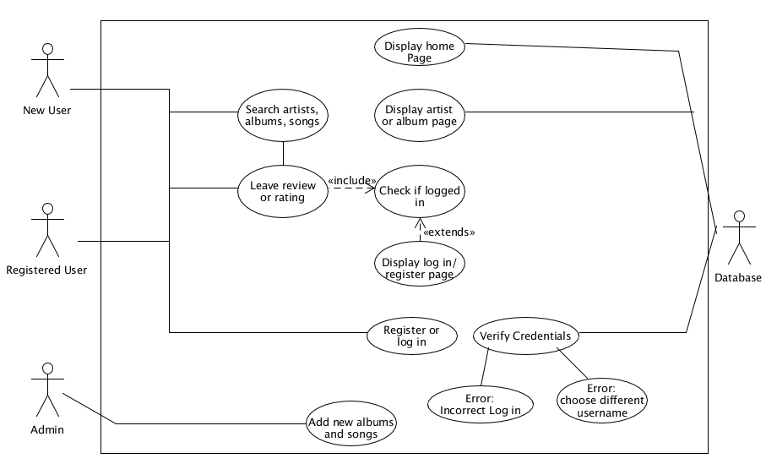
Use Case Diagram

Slide 9
Rotten Potatoes
Demo time!
http://project.codethree.net/

Slide 10
Mobile Demo
To the doc cam!

Slide 11
Difficulties and Triumphs
Difficulties:
Procrastinating
Underestimating complexity (lots of little things add up)
Getting cURL to work with Spotify API
Didn’t know anything about Android development at the beginning
Triumphs:
Finishing the project
Learned a lot about full stack development

Slide 12
Future Possibilities
Users have their own profile page
Saved and favorite albums and artists
Artists have their own profile page
List of albums and reviews
Overall average review
Authorization/Verification of users to become moderators
Enables uploading of new albums, artists, and songs
Countdown to upcoming album release dates
Tighter Spotify integration (using their artist/genre/album ID’s instead of having our own)

Slide 13
Questions
Ask away!
We’re group 14.

